Slide 1
Azure Cosmos DB
Develop AI-powered apps and agents at any scale

Slide 2
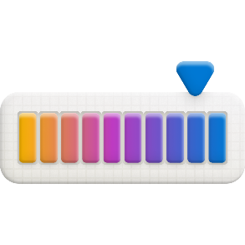
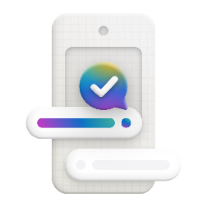
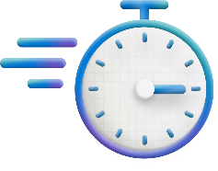



Today’s databases need to be ready to power AI apps and agents
To power intelligent apps, databases need…
To scale to any size
Built-in AI capabilities
Ability to deliver real-time experiences
Enterprise-grade security
SQL DB in Fabric

Slide 3

How Azure Cosmos DB solves this
App Dev Manager
Kian Lambert
Contoso
"I need to build a globally distributed AI app and want flexibility in how I store and access data"
Azure Cosmos DB enables Application Development Managers to build modern, multi-tenant, AI applications, supporting vector, full-text, and hybrid search with unmatched flexibility and elasticity.
Additionally, it uniquely offers industry leading availability with automatic multi-region, availability zone and per–partition failover with zero downtime or data loss.

Slide 4
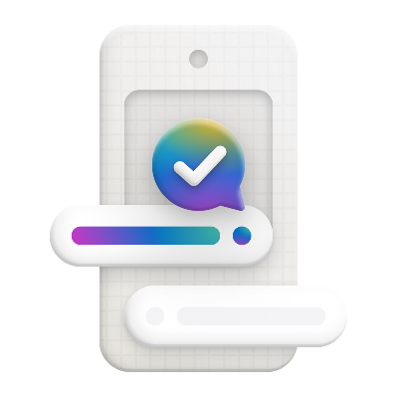

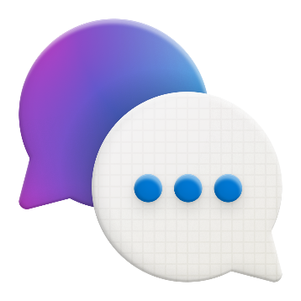

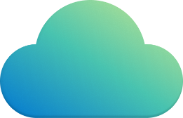

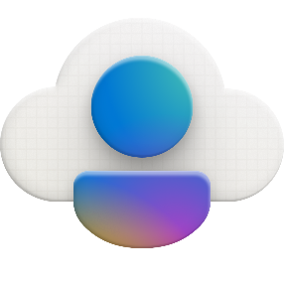
Azure Cosmos DB powers scalable, high-performance apps anywhere in the world
AI-powered apps
Internet of Things
Personalized recommendations
Order and payment processing
Multi-tenant SaaS applications
Notes:
These capabilities make Azure Cosmos DB ideally suited for modern application development, especially applications that: experience unpredictable spikes and dips in traffic, generate lots of data, need to scale to millions of tenants while delivering real-time user experiences, and are depended upon for business continuity.
Some of the most popular use cases for Azure Cosmos DB include IoT device telemetry, real-time personalization, serving dispersed user bases with high concurrent activity, and apps that are transactional in nature, such as online e-commerce, ad networks, and finance.
As an example that’s relevant to your business, let’s talk about <Speakers - jump to customer story best suited to your audience>

Slide 5

Sizzle video

Slide 6
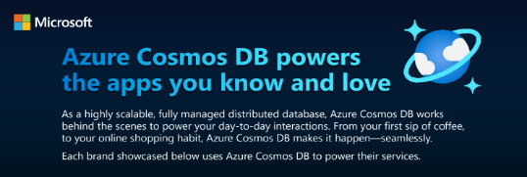
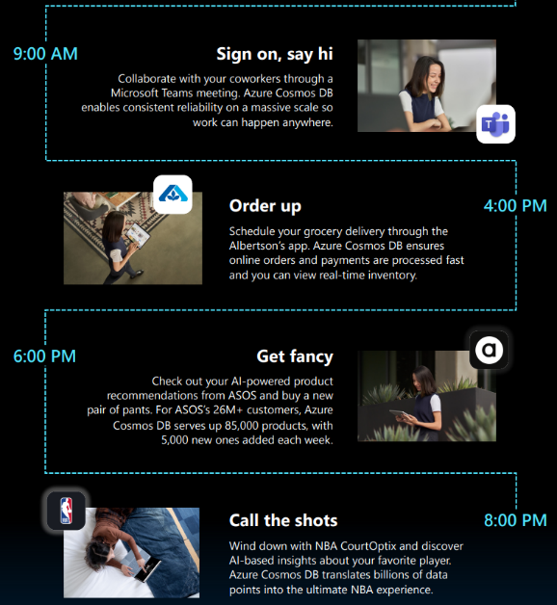
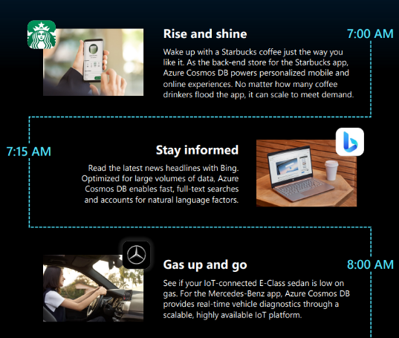
Azure Cosmos DB powers the apps you know and love

Slide 7





Azure Cosmos DB
Develop AI-powered apps and agents at any scale
AI-ready
Mission-critical scalable apps
Developer Productivity
Integrated Data Estate
Serverless Vector Search
Hybrid Search + Reranking
Seamless integration with Semantic Kernel & LangChain
5x 9’s High Availability
Fast (<10ms) @ any scale
Automatic Partitioning
Flexible JSON Schema
Automatic Indexing
Pay-Per-Req Serverless + Dynamic Autoscale
Microsoft Fabric integrated
Azure AppPlat integrated
Azure OpenAI and AI Foundry integrated

Slide 8
COMPREHENSIVE SLAs
RUN YOUR APP ON WORLD-CLASS INFRASTRUCTURE
Azure Cosmos DB is the only service with financially-backed SLAs for millisecond latency at the 99th percentile, 99.999% HA and guaranteed throughput and consistency
Latency
HA
Throughput
Consistency
<10 ms
99.999%
Guaranteed
Guaranteed
99th percentile
Notes:
HA 99.999% for multi-region read; 99.99% for single region deployments

Slide 9



Azure Cosmos DB is the go-to database for AI Apps
42% of Azure Cosmos DB usage comes from apps using AI
“We chose Cosmos DB as the main operational database for Open AI because of its automatic scaling and schemaless flexibility allowing us to iterate quickly.”
Nick Cooper Staff Engineer
Open AI
“”We use Cosmos DB as the ‘brain’ of our intelligent agreements management, We chose it for its flexible schemaless datamodel, and scalable and cost effective vector search capability”
Kunal Mukerjee
Vice President, AI, Docusign
“Cosmos DB vector and hybrid search is our top choice for semantic search over other options like Elastic.”
Zach Rossman Staff Engineer, AI & Security Veeam
“With our virtual assistant in particular, we have experienced the higher scale, higher availability, and faster time to market of using Azure Cosmos DB..”
Viju Chacko Head of Digital Architecture
Air India

Slide 10

Azure Cosmos DB
Develop AI-powered apps and agents at any scale
Key differentiators
206B daily transactions, 8PB
8x growth every 8 months
Chat history, memory, GPTs.
Personalization, 50+ usecases
Schemaless Flexibility allows rapid iteration, and semi-structured data
Fastest vector database with the lowest TCO, thanks to serverless, autoscale and industry leading DiskANN algorithm
Highly Elastic with serverless and instant autoscale options
High resiliency and performance with SLA-backed <10 ms latency and 99.999% availability
Billions
Thousands

Slide 11
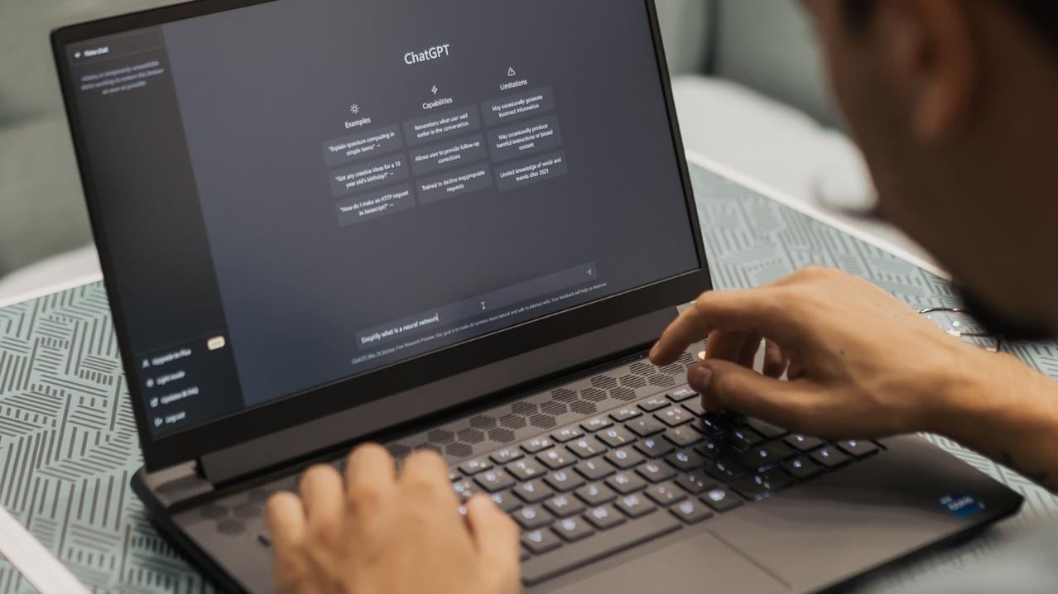
Satya Nadella Quote
“OpenAI relies on Cosmos DB to dynamically scale their ChatGPT service – one of the fastest-growing consumer apps ever – enabling high reliability and low maintenance.”
Satya Nadella Microsoft chairman and chief executive officer

Slide 12



TomTom
Data is the glue that holds everything together. Azure Cosmos DB as a globally distributed, scalable database enables the system to retain the previous customer conversations and preferences, allowing it to keep learning and become tailored to the driver.
Paul Hesen
Vice President of Product Management
Notes:
- TomTom is a location technology leader that provides mapping and navigation solutions for drivers, carmarkers, and developers. They built an AI-powered in-car automotive assistant, the Digital Cockpit, enabling drivers to use natural language to achieve certain tasks (like controling car functions and getting dining recommendations).
TomTom used Azure Cosmos DB to manage the extensive data needed for the Digital Cockpit. Azure Cosmos DB provides the necessary performance and capabilities to manage conversation history, essential for the functionality of the voice assistant, and for ensuring context-aware interactions that resemble human conversation.
You can hear all about how TomTom built their Digital Cockpit with Azure Cosmos DB and Azure AI services in a session on Wednesday (May 22) at 2:15 PM, Level 4, Room 425. Also, make sure to stop by our Expert Meet Up Hub where TomTom will be showcasing their Digital Cockpit live!

Slide 13
Bloomberg survey
Bloomberg survey
Azure Cosmos DB is the preferred database for AI apps
Who are your preferred database vendors for RAG, LLM customization? Rank top three.
26%
A recent Bloomberg survey of CIOs* found that Azure Cosmos DB is the preferred database for LLM and RAG generative AI workloads. This is due to features that are tailor-made for building intelligent apps like:
20%
14%
14%
Top choice
Ability to store and query vectors within Azure Cosmos DB with high-performance vector indexing powered by DiskANN
Dynamic scaling that allows partitions and regions to scale independently
Industry-leading SLA-backed 99.999 percent availability for NoSQL data
Azure Cosmos DB
Amazon MemoryDB
MongoDB
Google BigQuery
Source: ZDNET - Enterprises double their generative AI deployment efforts, Bloomberg survey says
Source: 60% of Enterprise Chief Information Officers Report Plans to Increase Spending on AI Inferencing Workloads with Microsoft

Slide 14
Azure Cosmos DB is the go-to database for AI Apps
42% of Azure Cosmos DB usage comes from apps using AI
“We chose Cosmos DB as the main operational database for Open AI because of its automatic scaling and schemaless flexibility allowing us to iterate quickly.”
Nick Cooper Staff Engineer
Open AI
“”We use Cosmos DB as the ‘brain’ of our intelligent agreements management, We chose it for its flexible schemaless datamodel, and scalable and cost effective vector search capability”
Kunal Mukerjee
Vice President, AI, Docusign
“Cosmos DB vector and hybrid search is our top choice for semantic search over other options like Elastic.”
Zach Rossman Staff Engineer, AI & Security Veeam
“With our virtual assistant in particular, we have experienced the higher scale, higher availability, and faster time to market of using Azure Cosmos DB..”
Viju Chacko Head of Digital Architecture
Air India

Slide 15
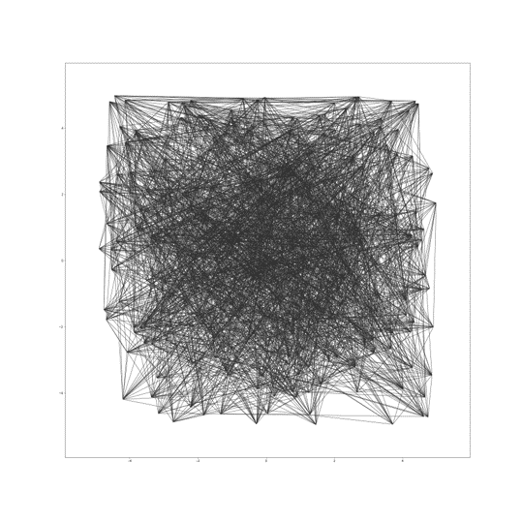

Microsoft DiskANN in Azure Cosmos DB
Cost-effective, low latency vector search at any scale
Vector compression
Storage and graph construction
Algorithms
Large Vectors
{ D1, D2, D3, D4, D5, …, D99, D100 }
RAM
Compressed vectors
Quantization
SSD
Compressed Vectors
{ D1, D2 .., D10 }
Full vectors + graph
Unlimited scale
Low latency
Robust to data changes
Serverless
Read the whitepaper: aka.ms/DiskANNCosmosDBWhitePaper

Slide 16
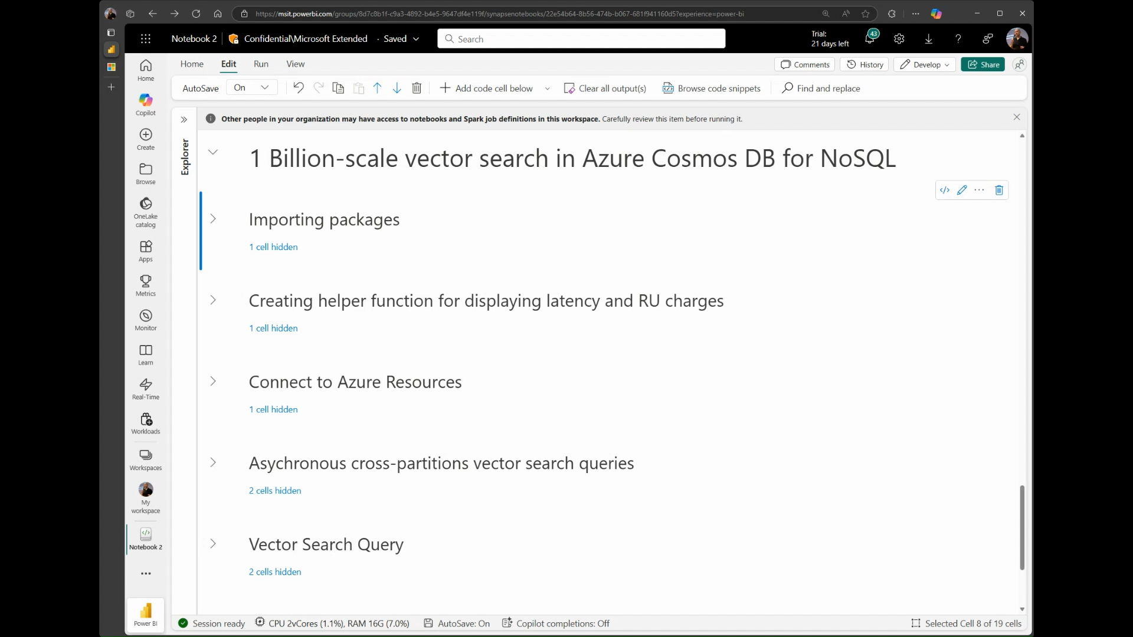
1B vector benchmark

Slide 17
Azure Cosmos DB – New, expanded, and combined search types create richer experiences
Generally available
Preview
Full-text and hybrid search
Full-text: phrase search
Full-text: fuzzy search
Full-text: multi-language support

Slide 18
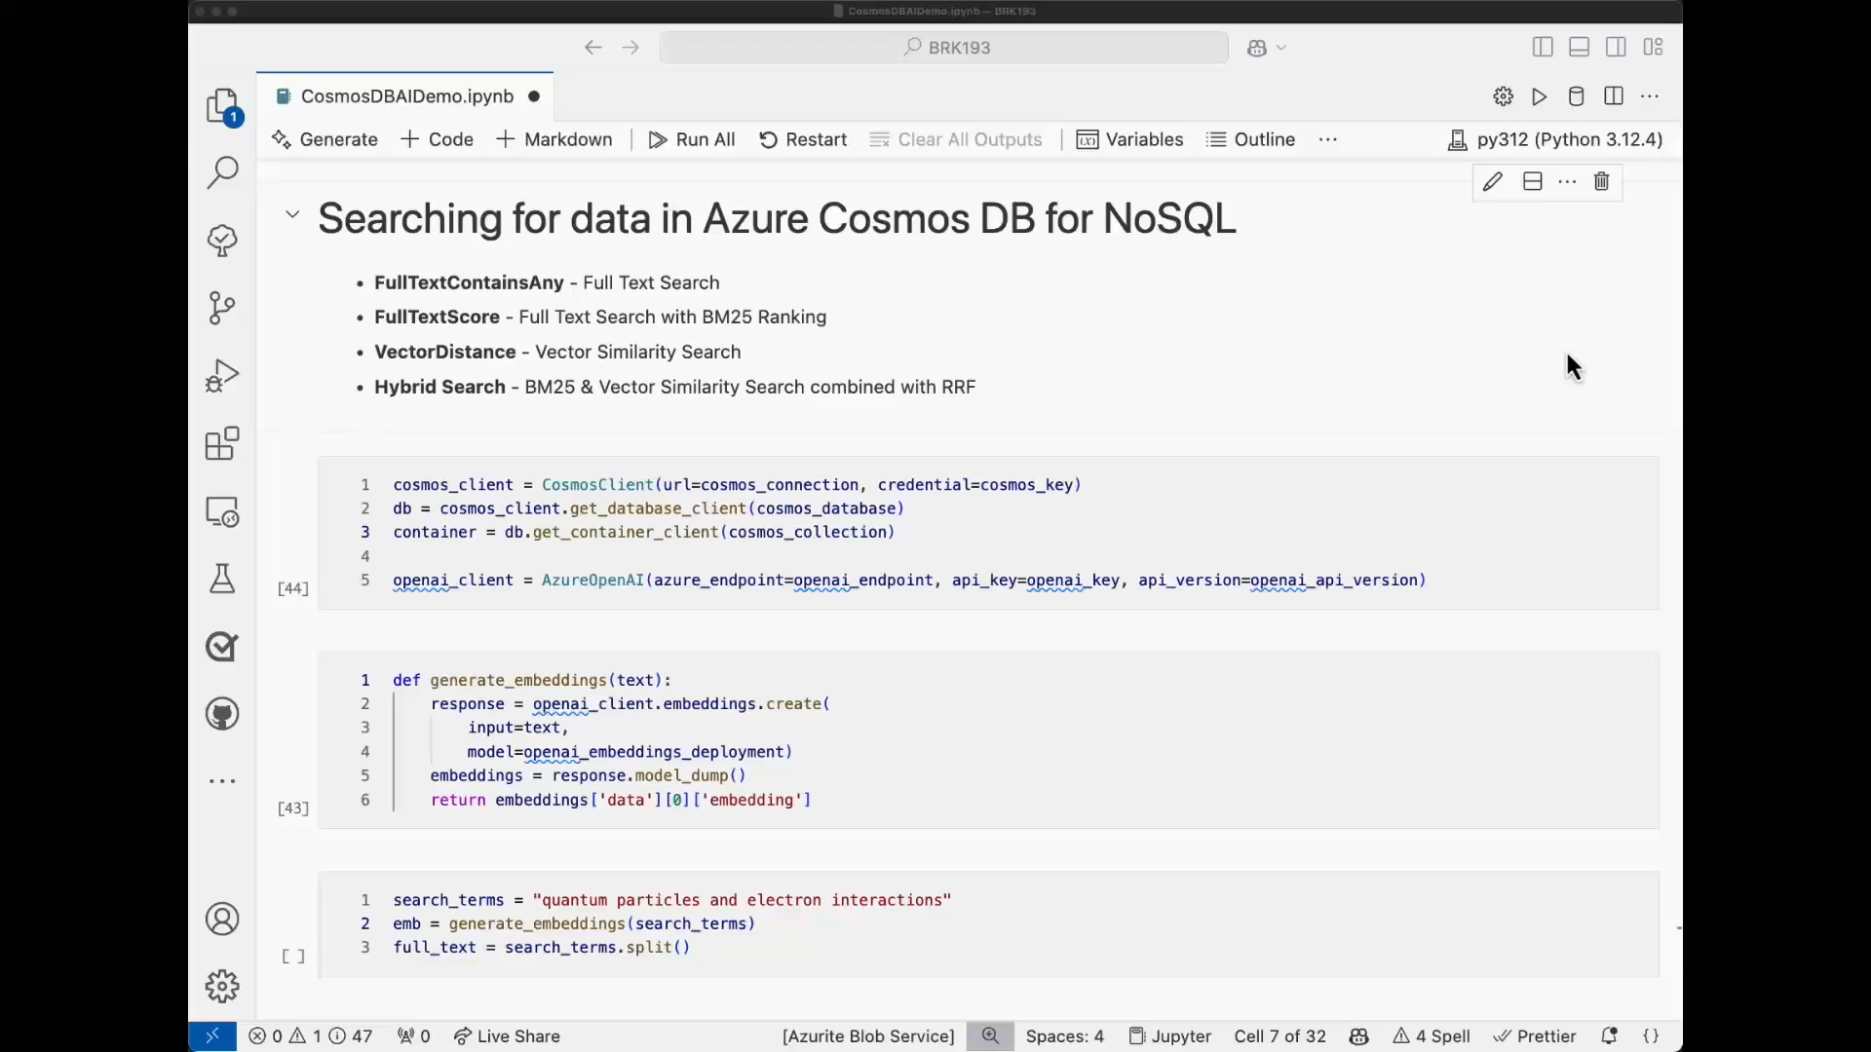
Demovideo

Slide 19
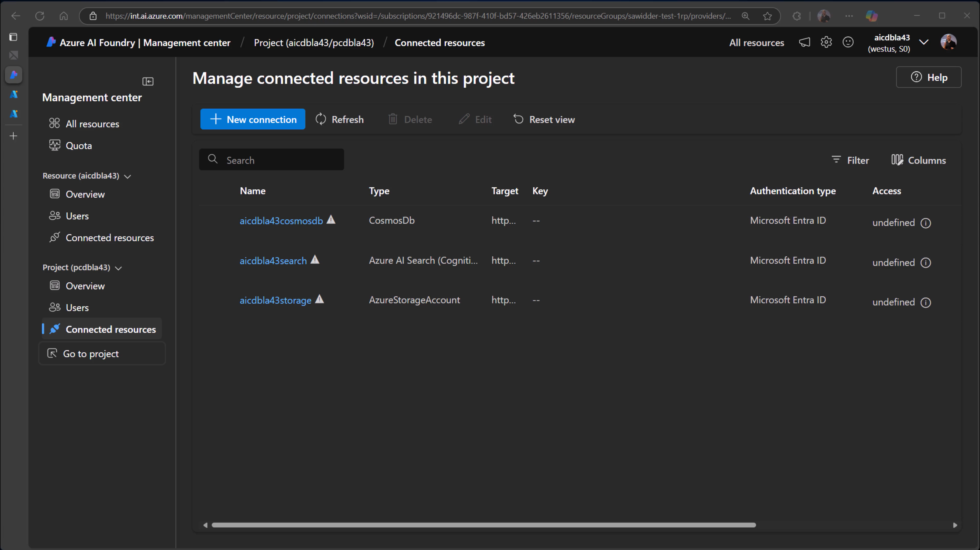
Demovideo2

Slide 20


Azure Cosmos DB offers two models for active-active 5 9’s resiliency
Multi-writer, RTO=0, RPO~0
Single-writer, RPO=0, RTO~0
Azure Traffic Manager
Azure Traffic Manager
App Region A
App Region B
App Region C
App Region A
App Region B
App Region C
Reads
Writes
active-active, leader-less
active-active, per-partition automatic failover
Multi-region writes
Per partition automatic failover

Slide 21
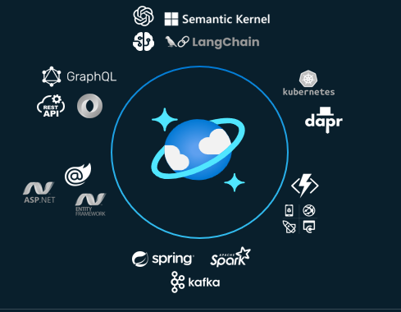
Effortless Developer Experience
Enables rapid iterations with ecosystem integrations
Flexible schema with automatic indexing enables rapid app iteration without schema/index management
Automatic scaling and automatic partitioning enables zero-devops while application grows rapidly
Best fit for the fast-growing ecosystems with seamless integration
Perpetual Free-tier designed to help succeed on key scenarios
Change Feed for Event Driven architectures
“We choose Cosmos DB because NoSQL schema permits rapid app iteration, and it met our scalability and reliability requirements vs our previous RDBMS”
- Nick Cooper, Member of Technical Staff @ OpenAI

Slide 22
Developers love building apps with Azure Cosmos DB
Azure Cosmos DB is an easy database to work with. Its schema-less nature allows us to iterate quickly on our platform, developer new features, and store the associated data in Azure.
Michael C. Kinectify
We use Azure AI Search for all of our search needs. The integration that Azure AI Search has with Azure Cosmos DB is very good. We heavily utilize the integration with Azure AI Search for a lot of the features on our website.
Karlo Z. Officer at Portnox
The uptime is very good. Over six years that we have been working with Azure Cosmos DB, it has not let us down even once. We never had any downtime with the service.
Yoni N. Zero Friction
The most valuable aspect of Cosmos DB is its performance. It serves as the foundation for OpenAI’s infrastructure, providing us with similar functionality. This not only prepares us for AI use cases but also efficiently supports our loyalty use cases.
Maria P. Bond Brand Loyalty

Slide 23

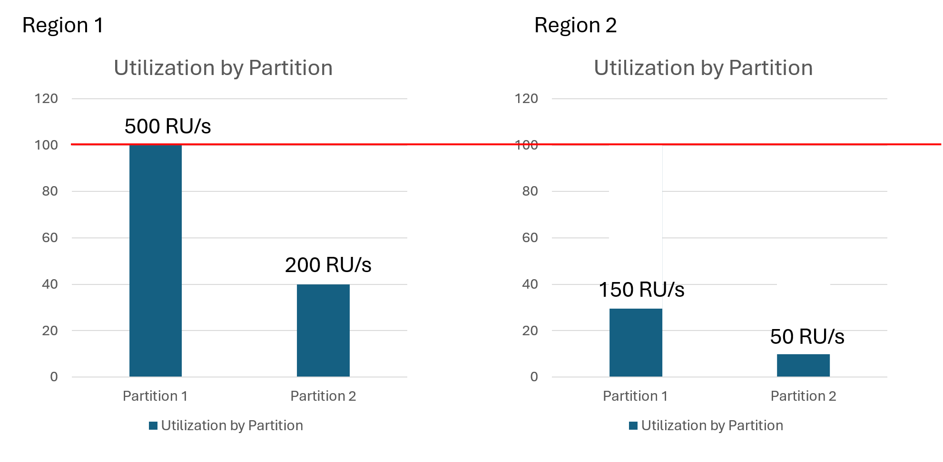
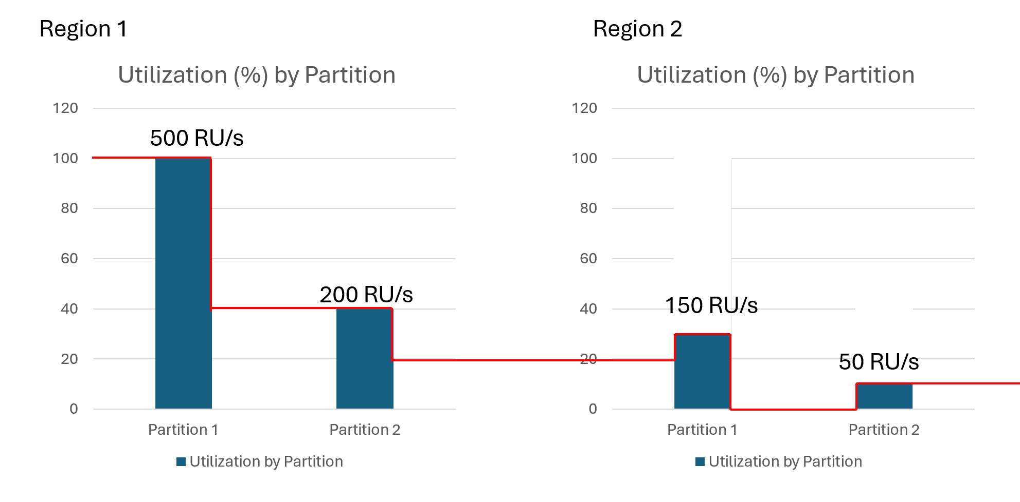
Dynamic scaling per partition and per region
Before dynamic scaling
For the hour, we are billed for 100% of the autoscale max R/Us for the total hour across both regions
In the new dynamic autoscale model, partitions and regions scale independently based on usage
This new feature helps customers to save costs in database workloads that have a highly trafficked primary region and a secondary passive region for disaster recovery
Dynamic scaling has provided cost optimizations between 15% to 70% on customer’s autoscale cost depending on their workload pattern during the public preview
We recommend this feature to all customers interested in autoscale
After dynamic scaling
For the hour, we are billed for max R/Us per partition and per region for the total hour

Slide 24



What customers are saying about dynamic autoscale
This feature not only streamlined our operations but also led to substantial cost savings.
Apurv Gupta, Founder, Mailmodo
With Dynamic Scaling for Azure Cosmos DB, we have been able to achieve 15% cost savings on average with zero intervention.
Vineeth Raj Director Engineering, Udaan
Since enabling Microsoft’s dynamic scaling feature within Azure Cosmos DB in May of this year (2024), we have realized an impressive 65% reduction in our monthly Azure Cosmos DB spend.
Joe MacKinnon Director IT – Business Enablement, SECURE Energy Services

Slide 25




Global Secondary Index
Primary Key
Partition Key + ID
PK: /PNR
GSI: /FF#
GSI
Email + ID
GSI: /email
GSI
Freq Flyer # + ID
Query by /PNR
Query by /email (without GSI)
Query by /email (with GSI)
✅
❌
✅
PNR (aka Booking / Reservation Code) | email | frequent_flyer | ticket_id | passenger_name | flight_number | departure_airport | arrival_airport | departure_date | booking_status
ABC123 | alice.wonderland@example.com | FLR0192837465 | BKG001 | Alice Wonderland | ZX105 | SEA | SFO | 5/15/2025 | Confirmed
DEF456 | bob.builder@example.org | FLR9876543210 | BKG002 | Bob The Builder | ZX228 | JFK | LAX | 6/1/2025 | Confirmed
GHI789 | charlie.brown@example.net | FLR1122334455 | BKG003 | Charlie Brown | ZX300 | ATL | MIA | 5/22/2025 | Checked-in
JKL012 | dorothy.gale@example.com | FLR5544332211 | BKG004 | Dorothy Gale | ZX477 | PDX | SAN | 7/10/2025 | Cancelled
MNO345 | eve.harrington@example.org | FLR6789012345 | BKG005 | Eve Harrington | ZX512 | ORD | BOS | 6/15/2025 | Confirmed
PQR678 | frank.monster@example.net | FLR5432109876 | BKG006 | Frankenstein Monster | ZX633 | DFW | PHX | 5/1/2025 | Boarding
STU901 | greta.garbo@example.com | FLR0009991112 | BKG007 | Greta Garbo | ZX789 | LAX | JFK | 7/20/2025 | Confirmed
VWX234 | han.solo@example.org | FLR2228883334 | BKG008 | Hans Solo | ZX840 | SAN | PDX | 6/25/2025 | Hold
YZA567 | indiana.jones@example.net | FLR4567890123 | BKG009 | Indiana Jones | ZX901 | BOS | ORD | 5/10/2025 | Confirmed
BCD890 | juliet.capulet@example.com | FLR3210987654 | BKG010 | Juliet Capulet | ZX022 | MIA | ATL | 8/1/2025 | Confirmed
Notes:
Global Secondary Indexes (previously known as materialized views), now in preview, are read-only containers that automatically sync data from a source container.
An independent partition key and data model allows index fine-tuning to suit any query pattern and to avoid cross-partition queries on source data. The new addition of WHERE filters ensure indexes only contain the most critical data for each use case.

Slide 26

Azure Cosmos DB – Fleet Management
Monitor, manage, and scale Azure Cosmos DB for multi-tenant apps
Easy to manage & monitor
Good isolation & performance
Low cost per tenant
Cosmos DB for Tenant 1
…
Cosmos DB for Tenant 2
Cosmos DB for Tenant 1000
New fleet APIs to manage, monitor, and make changes across thousands of databases
Enables data and security isolation at tenant level, with account per tenant architecture
Elastically scale and pool RU/s across databases in fleet, with controls for guaranteed performance
Enables ISVs to build multi-tenant apps with strong tenant isolation + low cost per tenant

Slide 27



Throughput Pooling
Lower Cost
Don’t need to provision peak RU/s for every tenant
Better performance
Collections that get 429s use idle RU/s from pool
Guarantees against noisy neighbor
Dedicated RU/s are always guaranteed (even when all resources active)

Slide 28

video

Slide 29
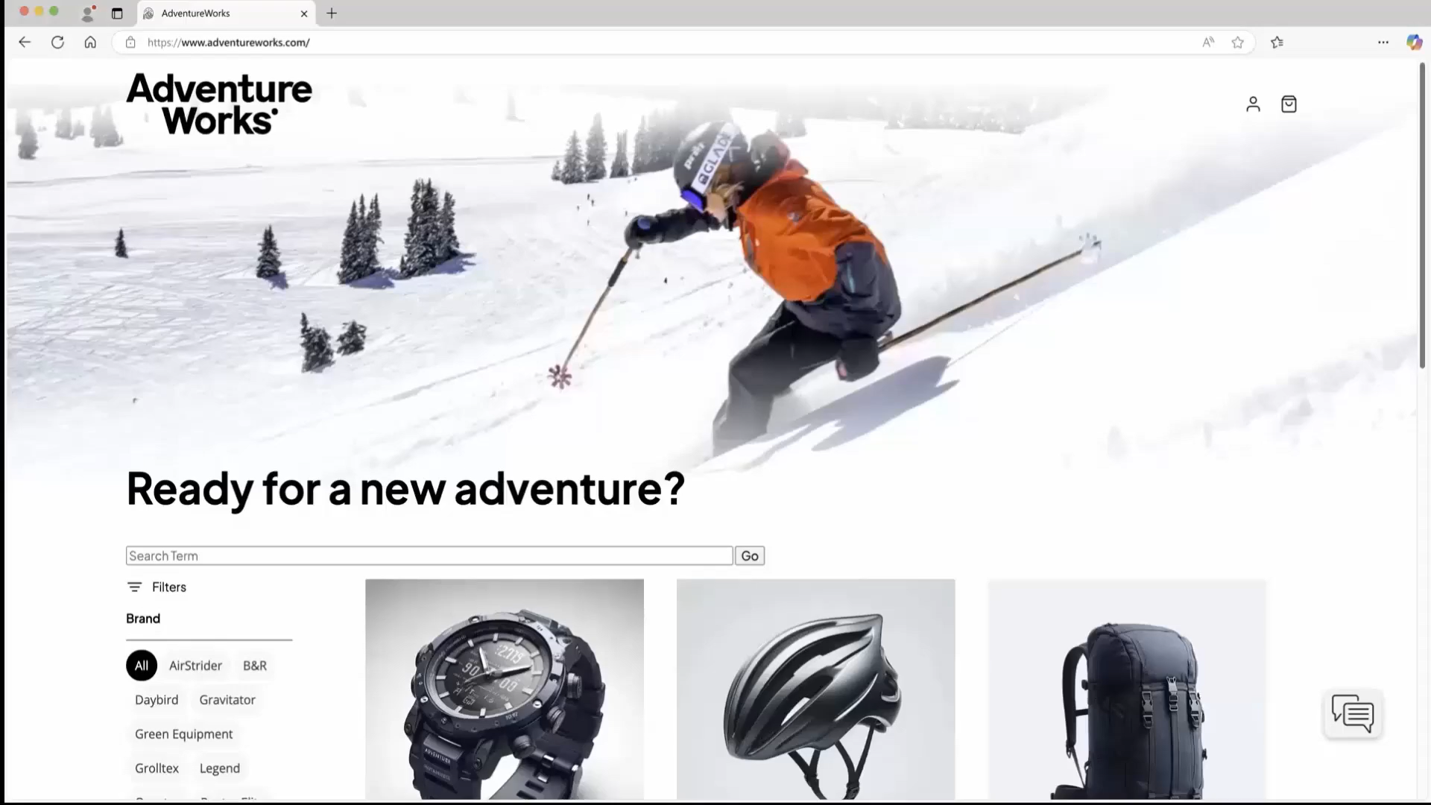
Demovideo3

Slide 30

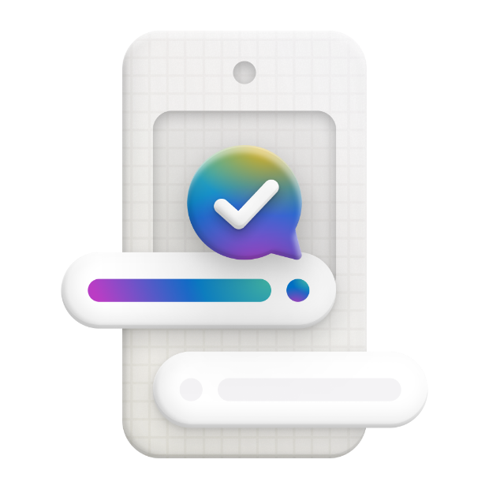

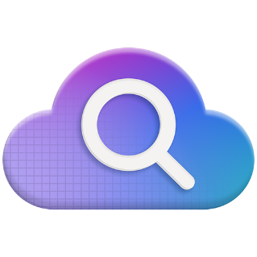



Integration with AI tools and services
Easily build AI apps and agents with Azure Cosmos DB and Azure AI Services with little or no coding!
Integrate Azure Cosmos DB data and vector store with LangChain and Semantic Kernel to build RAG applications.
Store threads and chat history in Azure Cosmos DB to maintain context and to offer personalized experiences.
Use Azure AI Foundry to build copilots and agents faster with prebuilt and customizable models, using your data to innovate at scale
Azure OpenAI Service
Azure AI Search
Azure AI Foundry
Semantic Kernel
LangCHain

Slide 31
Handle any data with no schema or indexing required
Azure Cosmos DB’s schema-less service automatically indexes all your data, regardless of the data model, to delivery blazing fast queries.
Automatic index management
Synchronous auto-indexing
No schemas or secondary indices needed
Works across every data model
GEEK
Item | Color | Microwave safe | Liquid capacity | CPU | Memory | Storage
Geek mug | Graphite | Yes | 16ox | ??? | ??? | ???
Coffee Bean mug | Tan | No | 12oz | ??? | ??? | ???
Surface book | Gray | ??? | ??? | 3.4 GHz Intel Skylake Core i7-6600U | 16GB | 1 TB SSD
Notes:
Look at Andrew’s “variety” slide
Automatic and synchronous indexing of all ingested content - hash, range, geo-spatial, and columnar
No schemas or secondary indices ever needed
Resource governed, write optimized database engine with latch free and log structured techniques
Online and in-situ index transformations
While the database is fully schema-agnostic, schema-extraction is built in
Customers can get Avro schemas from the database

Slide 32
Trust your data to industry-leading Security & Compliance
Azure is the world’s most trusted cloud, with more certifications than any other cloud provider.
Enterprise grade security
Encryption at Rest
Encryption is enabled automatically by default
Comprehensive Azure compliance certification
Notes:
Encryption at Rest
Always encrypted at rest and in motion
Data, index, backups, and attachments encrypted
Encryption is enabled automatically by default
No impact on performance, throughput or availability
Transparent to your application
Comprehensive Azure compliance certification
ISO 27001, ISO 27018, EUMC, HIPAA, PCI
SOC1 and SOC2 (Audit complete, Certification in Q2 2017)
FedRAMP, IRS 1075, UK Official (IL2) (Q2 2017)
HITRUST (H2 2017)

Slide 33

TomTom brings AI-powered, talking cars to life with Azure
We use Azure OpenAI Service, Azure Cosmos DB, and Azure Kubernetes Service because we’ve identified these as key services that facilitate the acceleration of AI apps.
Ivan Diaz: Principal Staff Engineer for AI Services
TomTom’s Digital Cockpit understands 95% of complex requests, improving response time from 12 seconds to 2.5 seconds
Challenge
TomTom changed the way drivers reached their destinations with its navigation solution. The company recognized that today’s drivers want more than just the best route.
Outcomes
Partnering with Microsoft, TomTom created Digital Cockpit, an immersive in-car infotainment system, using Azure OpenAI Service, Azure Cosmos DB, and Azure Kubernetes Service.
Automobile manufacturers can customize Digital Copilot to the look and feel of the brand, cutting costs by up to 80% with a more efficient, sustainable approach.

Slide 34

Air India elevates customer support while saving money with Azure AI, data, and apps
We are on this mission of building a world-class airline with an Indian heart. To accomplish that goal, we are becoming an AI-infused company, and our collaboration with Microsoft is making that happen.
Dr. Satya Ramaswamy: Chief Digital and Technology Officer
Generative AI in multiple applications is positioning the airline for continued growth.
Challenge
As part of a transformation intended to restore its status as a world-class airline with a strong Indian identity, Air India needed to upgrade the customer experience without increasing costs.
Outcomes
Air India used Azure OpenAI Service to develop AI.g, one of the world’s first airline virtual assistants based on generative AI.
As Air India has doubled its passenger count, AI.g has handled 97% of queries with full automation and avoided millions of dollars in customer support costs.

Slide 35
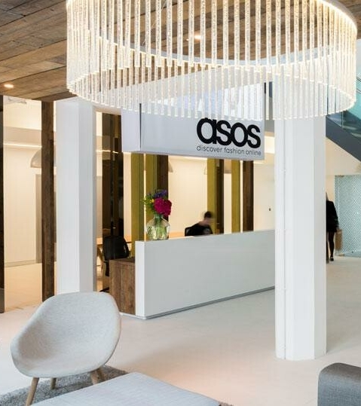

ASOS
Intelligent engine running on Azure Cosmos DB and Azure Machine Learning, providing real-time product recommendations and instant order updates for 26M+ global customers
“We chose Azure Cosmos DB because of its global distribution and ability to handle heavy seasonal bursts like Black Friday.”
Azure Cosmos DB delivers:
<10 ms latency reads and writes
Global data distribution
Instant elastic scalability
Change feed for order workflows and microservices
Bob Strudwick
Chief Technology Officer
Notes:
Challenge
ASOS ecommerce platform needed to offer real-time product recommendations and scale to meet seasonal demand and instant update with high reliability in any location.
Outcome Reimagined microservices architecture in a global distribution of 30 datacenters that ensures automated resiliency and high levels of performance for customers in any location, and a recommendations platform for 26mm+ customers includes 85,000 products, with 5,000 new ones added each week.
ASOS uses Azure Cosmos DB across numerous microservices, including:
low-latency data store for tasks such as storing and retrieving precalculated user profiles and product machine learning models to generate real-time recommendations
Order workflows using change feed functionality to broker communication between event-driven microservices that handle various stages of the order workflow as a persistent event store, so customers can easily track their orders
easy-to-use online returns process. Customers can request a return online, download the return label, and get refunded with just a few easy steps
Highly scalable distributed order processing workflow that has gone from processing tens of orders per second to hundreds of orders per second (ASOS was able to process 95 million orders in FY21 with Azure Cosmos DB)

Slide 36


East West Bank
Real-time payment transactions and ability to ingest any type of data
“We wanted the capability to ingest any type of data that comes into our system. Azure Cosmos DB gives us the ability to process transactions in real time and enables the services-based infrastructure that we require.”
Azure Cosmos DB delivers:
<10 ms latency reads and writes
Global data distribution
Instant elastic scalability
Change feed for transaction workflows and microservices
Sunil Kumar
VP of Engineering, East West Bank
Notes:
Challenge
ASOS ecommerce platform needed to offer real-time product recommendations and scale to meet seasonal demand and instant update with high reliability in any location.
Outcome Reimagined microservices architecture in a global distribution of 30 datacenters that ensures automated resiliency and high levels of performance for customers in any location, and a recommendations platform for 26mm+ customers includes 85,000 products, with 5,000 new ones added each week.
ASOS uses Azure Cosmos DB across numerous microservices, including:
low-latency data store for tasks such as storing and retrieving precalculated user profiles and product machine learning models to generate real-time recommendations
Order workflows using change feed functionality to broker communication between event-driven microservices that handle various stages of the order workflow as a persistent event store, so customers can easily track their orders
easy-to-use online returns process. Customers can request a return online, download the return label, and get refunded with just a few easy steps
Highly scalable distributed order processing workflow that has gone from processing tens of orders per second to hundreds of orders per second (ASOS was able to process 95 million orders in FY21 with Azure Cosmos DB)

Slide 37


Zero Friction
SaaS platform that provides efficient heat metering and billing for heat suppliers and 12,000+ end customers.
“We’ve built a unique solution for our industry because we use a SaaS concept, which makes it very affordable and scalable.”
Azure Cosmos DB delivers:
Massive scale
Support for major traffic spikes
SLA-backed high availability
Cost efficiency with serverless and multitenant billing
Yoni Nijs
Cofounder, CTO, and Product Lead, Zero Friction
Notes:
https://youtu.be/DqQuXGjaE8c
Microsoft Customer Story-Zero Friction delivers frustration-free metering and billing to the energy sector with Azure Cosmos DB

Slide 38


Citrix makes apps and data secure and easy to access anywhere, at any time
Challenge
Citrix was using MongoDB databases to power a web portal identity system that was disjointed and didn’t perform well. It needed a single sign-on solution it could trust to stay available so customers around the world could be able to sign in anytime.
Solution
Azure Cosmos DB delivered:
Guaranteed 99.999% availability
<10 ms latency response times
Global scalability to handle more than 10 million Citrix users
Support for rich queries over automatically indexed data
“We needed a solution to support a mission-critical service that handles over 10 million Citrix users worldwide. Azure provides the necessary enterprise-grade SLAs and low-latency response times at high load to give us peace of mind.”
Tom Kludy
Principal Architect, Citrix
Notes:
#MongoDB, #migration, #autoindex, #ISV
https://customers.microsoft.com/en-us/story/citrix

Slide 39
ASOS (1 of 2)
Intelligent engine running on Azure Cosmos DB and Azure Machine Learning, providing real-time product recommendations and instant order updates for 26M+ global customers.
Azure Cosmos DB delivers:
<10 ms latency reads and writes
Global data distribution
Instant elastic scalability
Change feed for order workflows and microservices
Notes:
Challenge
ASOS ecommerce platform needed to offer real-time product recommendations and scale to meet seasonal demand and instant update with high reliability in any location.
Outcome Reimagined microservices architecture in a global distribution of 30 datacenters that ensures automated resiliency and high levels of performance for customers in any location, and a recommendations platform for 26mm+ customers includes 85,000 products, with 5,000 new ones added each week.
ASOS uses Azure Cosmos DB across numerous microservices, including:
low-latency data store for tasks such as storing and retrieving precalculated user profiles and product machine learning models to generate real-time recommendations
Order workflows using change feed functionality to broker communication between event-driven microservices that handle various stages of the order workflow as a persistent event store, so customers can easily track their orders
easy-to-use online returns process. Customers can request a return online, download the return label, and get refunded with just a few easy steps
Highly scalable distributed order processing workflow that has gone from processing tens of orders per second to hundreds of orders per second (ASOS was able to process 95 million orders in FY21 with Azure Cosmos DB)

Slide 40
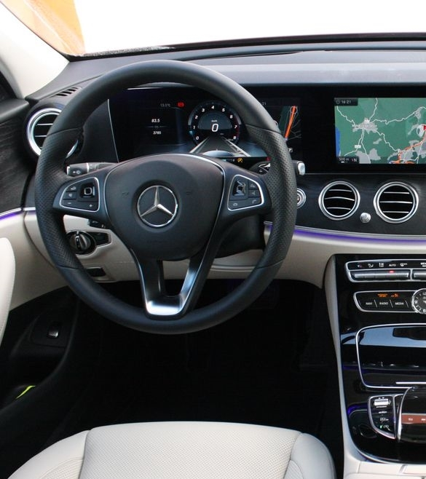

Mercedes-Benz (1 of 2)
A cloud-native IoT solution for an in-car digital experience that runs on Azure Cosmos DB and Azure Kubernetes Service
Azure Cosmos DB delivers:
Global data distribution
High availability
Low latency reads and writes worldwide

Slide 41
Azure cosmos db
A globally distributed, massively scalable, multi-model database service.
Multi-model data with your favorite API
Elastically scale storage and throughput
Multiple, well-defined consistency levels
<10ms latency guarantees at the 99th percentile
Industry-leading SLAs across performance, latency, availability and throughput
Lift and shift MongoDB apps
Run Spark over operational data
Build real-time customer experiences
Ideal for IoT, gaming and eCommerce

